Slide 1
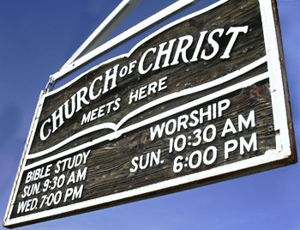
Notes:
While 1832 saw both groups inspired by the restorations of Stone and Campbell merge through the hand shake between Stone and “Raccoon” John Smith, this commitment to restoration and unity would not last. While the first few decades of the 19th century saw significant growth, the late 1840s and early 1850s saw difficulties that needed to be confronted. Worldly issues were finding their way into the church. The same issues that divided the north and south that led to the civil war were also dividing brethren and when the war came, thousands of Christians put on uniforms and fought. Ed Harrell once wrote, “In the heat of passion, disciples killed their own brethren.” Even when the war ended, animosities remained and internal issues deepened the strains.
In this lesson, we’ll study some of the differences that divided restorers in the mid 19th century through the 20th century and continue to divide brethren today.

Slide 2
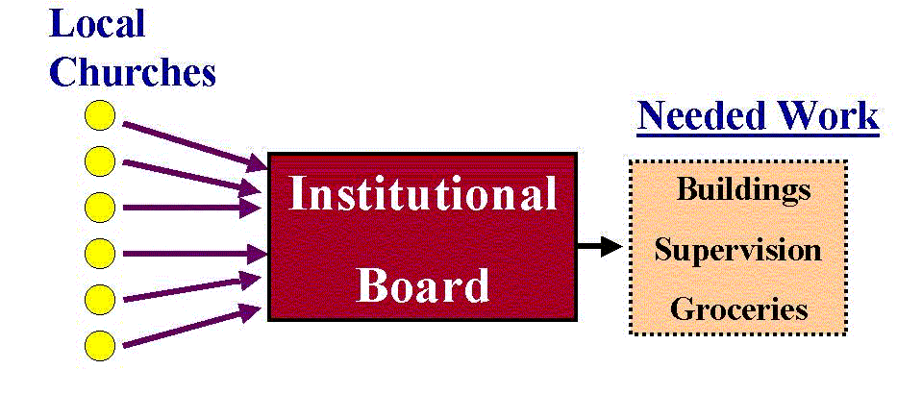
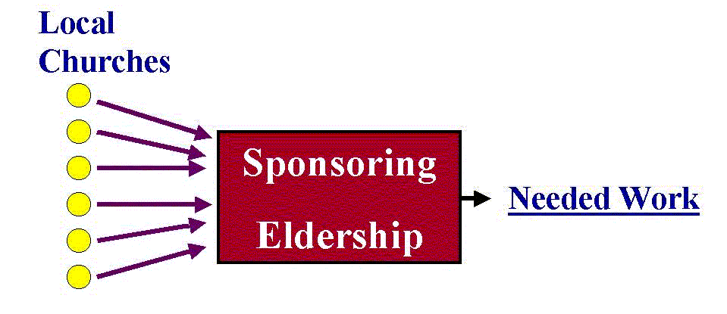
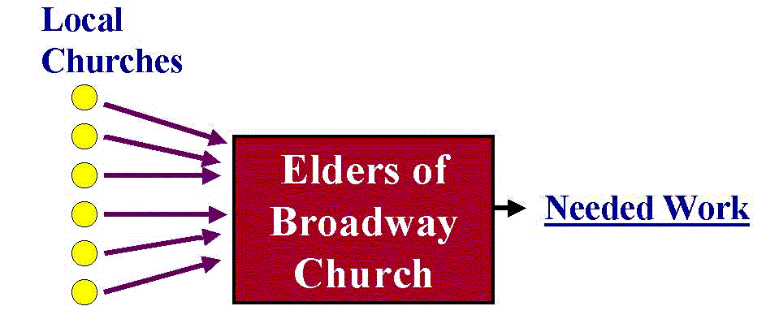
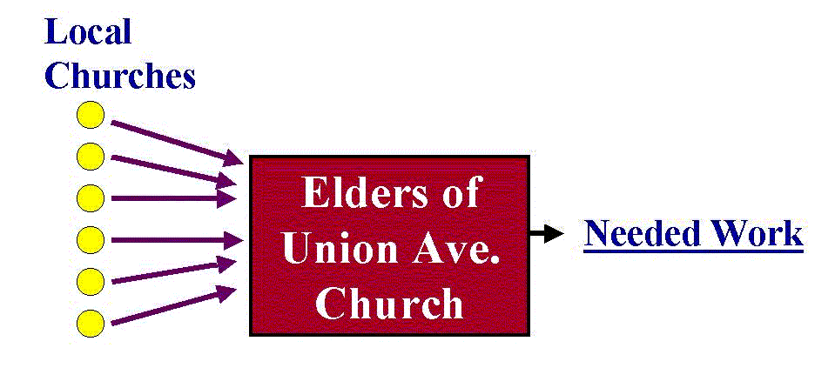
Middle-Man Organizations
American Christian Missionary Society (1849)
Institutional Boards
Missionary Societies
Orphans Homes
Bible Colleges
Issue:
Not the NT pattern
Centralizes influence
Issue of organization, not expediency
Collective vs. Concurrent Cooperation
Notes:
In October 1849, the American Christian Missionary Society was established by the Christian Church. This was initially opposed by Alexander Campbell and then further opposed by many others when they decided to side with the Union in the Civil War. This eventually led to a separation of the Churches of Christ from the Christian Church (Disciples of Christ).
In the 1950s, debates began over whether or not institutional boards (middle man organizations) could be used to facilitate and enhance the work of the church. And so some churches came up with an idea to create a board of directors (institutional board) over an orphan home, bible college, etc. Letters would then be sent to individual churches asking them to participate in this work. Money would then be sent from churches to these boards and they would then have oversight in providing buildings, supervision, groceries etc. in the case of orphans homes and buildings, supervision, teachers, etc. for bible colleges and evangelists, supplies, etc. in the case of missionary societies.
One example of this happened at the end of World War II when some brethren thought it would be a good time to start evangelizing those nations defeated in the war. The Broadway Church of Christ in Lubbock sent letters to churches asking them to send money to them and then they would handle the task of evangelizing Germany. So the German work was done by churches of Christ but overseen by the elders of one church of Christ.
Another example is the Union Ave Church of Christ in Memphis, TN. They became interested in evangelizing Japan. And so they sent letters to churches asking for money to so that that eldership could oversee that work. This is one eldership overseeing the work of many churches.
What is wrong with this?
First, there is no NT pattern for creating a middle man, institutional board to oversee the work of several churches. There is no authority for it.
Secondly, this leads to a centralizing influence. No greater example exists than the sponsoring eldership that oversaw the Herald of Truth radio and television program. When it first began, it focused on the one true church, baptism for the remission of sins, convincing people to restore NT Christianity. Millions supported it and tuned into it. Eventually, though, its message became less doctrinal and focused more on self-image, inner peace, etc. By the 70s and 80s, most churches who supported this were not teaching doctrinal sermons. The Herald of Truth became a centralized influence that hurt churches.
Third, it confused the issue of expediency vs. organization. Those who supported these middle man organizations claimed it was just an expedient way to carry out the work of the church. If that were the only issue in question, we couldn’t make much of an argument. However, any expediency that violates the NT is unlawful. In this case, the “expediency” violates God’s design for the organization of the NT church. Elders are to oversee the flock of God among them. The sponsoring church arrangement has one eldership overseeing the work of several churches.
Fourth, it turned concurrent cooperation into collective cooperation. Churches in the NT definitely worked concurrently (each sending relief to the same location) but did so over the independent oversights of their elders. This is not an issue of whether we are to be anti-cooperative. It’s an issue of cooperating the way churches of the NT cooperated.

Slide 3
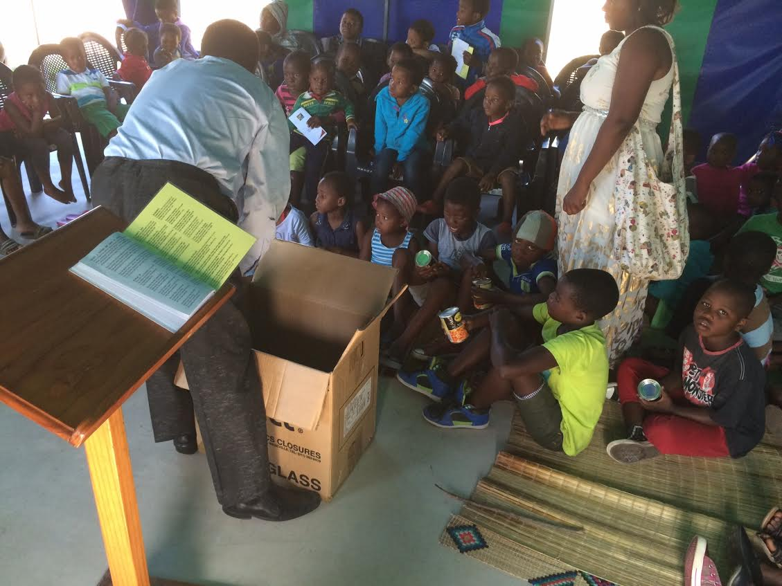
Middle-Man Organizations
Bible Pattern
Funds went directly to the need
Acts 4:32-35 – “³²And the congregation of those who believed were of one heart and soul; and not one of them claimed that anything belonging to him was his own, but all things were common property to them. ³³And with great power the apostles were giving testimony to the resurrection of the Lord Jesus, and abundant grace was upon them all. ³⁴For there was not a needy person among them, for all who were owners of land or houses would sell them and bring the proceeds of the sales ³⁵and lay them at the apostles’ feet, and they would be distributed to each as any had need.”
Notes:
What is the pattern? When we read the NT, the funds from churches simply went to where the need existed. They never sent their funds to a “middleman organization”, whether an institutional board or sponsoring eldership. In Acts 4, there was only one church in Jerusalem at that point and the apostles were acting in lieu of elders (no elders are mentioned until Acts 11). People brought their money and laid it at the Apostles’ feet so that the distribution could be made at that church.

Slide 4
Middle-Man Organizations
Bible Pattern
Funds went directly to the need
Acts 6:1-3 – “¹Now at this time while the disciples were increasing in number, a complaint arose on the part of the Hellenistic Jews against the native Hebrews, because their widows were being overlooked in the daily serving of food. ²So the twelve summoned the congregation of the disciples and said, ‘It is not desirable for us to neglect the word of God in order to serve tables. ³Therefore, brethren, select from among you seven men of good reputation, full of the Spirit and of wisdom, whom we may put in charge of this task.’”
Notes:
A problem arose in Acts 6. The Grecian widows were being neglected in the daily distribution. The apostles didn't reply, “We need a central organization and we'll send our money to this central organization so they can see that this is done right.” No, they appointed seven men, within their number, who could see after this matter. It was all done within the framework of the local congregation. The money simply went to where the need was.

Slide 5
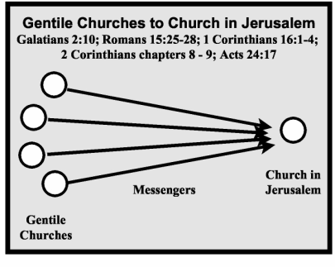
Middle-Man Organizations
Bible Pattern
Funds went directly to the need
Acts 11:27-30 – “²⁷Now at this time some prophets came down from Jerusalem to Antioch. ²⁸One of them named Agabus stood up and began to indicate by the Spirit that there would certainly be a great famine all over the world. And this took place in the reign of Claudius. ²⁹And in the proportion that any of the disciples had means, each of them determined to send a contribution for the relief of the brethren living in Judea. ³⁰And this they did, sending it in charge of Barnabas and Saul to the elders.”
Notes:
In Acts 11:27-30, the funds were sent to the elders. Which elders? The elders where the need was and not a middleman organization, a board of directors, or a wealthy large eldership somewhere. They sent it to the elders by the hands of Barnabas and Saul. They money went to where the need was.

Slide 6
Middle-Man Organizations
Bible Pattern
Funds went directly to the need
Rom 15:25-26 – “²⁵but now, I am going to Jerusalem serving the saints. ²⁶For Macedonia and Achaia have been pleased to make a contribution for the poor among the saints in Jerusalem.”
Phil 4:15-16 – “¹⁵You yourselves also know, Philippians, that at the first preaching of the gospel, after I left Macedonia, no church shared with me in the matter of giving and receiving but you alone; ¹⁶for even in Thessalonica you sent a gift more than once for my needs.”
Notes:
In Rom 15:25-26, churches from Macedonia and Achaia sent the money to the elders in Jerusalem. In Acts 21, we know this occurred at the end of Paul’s 3rd missionary journey as Paul arrived in Jerusalem with representatives from the churches, i.e. Luke (joined from Philippi). In Acts 21:19, we learn he met with the elders in Jerusalem and told them about all that had been done amongst the Gentile churches in Jerusalem, which would have included the contribution brought for the poor saints in Jerusalem. The money went to where the need was.
In Phil 4:15-16, the church in Philippi sent money to Paul in prison – right to where the need was. This is the NT pattern that we see.
So what we should do today is find out where the need is and send directly to the need. If we do this, we might make some mistakes. We're going to err in judgment all along. But we will at least be staying with the NT pattern. The issue has to do with middleman organizations standing between churches and the work to be done. It may be a board of directors or an overseeing eldership. But wherever you have a "middleman organization", you’ve left the pattern of sending directly to where the need is.

Slide 7
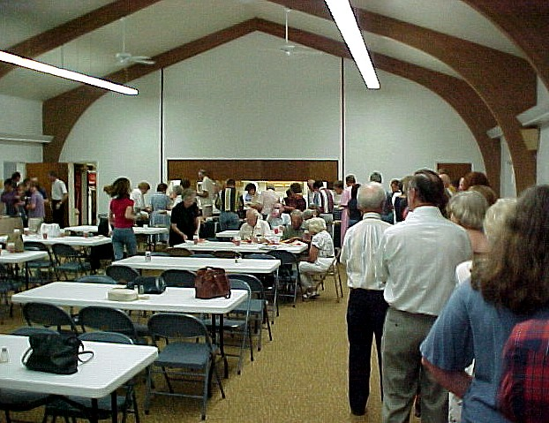
Kitchens & Fellowship Halls
By the end of 1960, new buildings included fellowship halls and kitchens
Not the issue:
Whether we can eat in the building
Whether the building is sacred
The issue:
Is there authority for local churches to provide social activities?
Notes:
By the end of 1960, many new church buildings were starting to include fellowship halls and kitchens to provide meals for the members and any other visitors before or after assemblies. Some began to question whether the church had the authority to provide such services.
The issue was not whether it was ok to eat in the church building. Some made the accusation that those who disagreed would have to prevent a mother from even giving her baby a bottle of milk in the building. But eating in the church building was never the issue that was raised.
The issue was not whether the building is sacred. While the building is certainly not sacred, it is used for spiritual purposes and it therefore needs to be considered whether providing and funding a place for eating/recreating is part of the spiritual service incumbent upon the work of the church.
The issue was always authority. Did God intend for local churches to provide, from its treasury taken on the first day of the week, a place for eating, recreating, or for social activities?

Slide 8
Kitchens & Fellowship Halls
Things Local Churches Are Authorized To Do
Assemble: Heb 10:24-25; Acts 20:7
We’ve purchased a building to provide a place to assemble
Observe the Lord’s Supper: Acts 20:7; 1 Cor 11:33
We’ve provided a table, bread and fruit of the vine, and trays
Sing psalms, hymns, and spiritual songs: 1 Cor 14:23; Eph 5:19; Col 3:16
Song books, projector, screen
Pray: 1 Cor 14:15-17; Acts 12:5,12; 16:25
Microphone
Preach: Acts 20:7; 1 Cor 14:26
Pulpit, projector, microphone, classrooms
Lay by in store: 1 Cor 16:2
Tray
Support Preachers: 1 Cor 9:14; 2 Cor 11:8-9
Treasury
Benevolence: Acts 4:34-35
Buy a house, pay somebody to supervise, buy groceries, etc.
Point: Can we find authority for the local church funding for social activities such that we’d need to provide a room for eating together?
Notes:
There are certain things that are authorized from scripture that we are allowed to do as a church and with out treasury.
We are commanded to assemble, and therefore a decision must be made where that must be as God’s word doesn’t provide a clear path as to the nature of the place. Therefore, if called for, we provide a building to facilitate this command.
There are things we are to do when we assemble according to scripture, observe the Lord’s Supper, sing songs, pray, preach, and lay by in store. Therefore we provide expediencies to facilitate these obligations in items such as song books, bread and fruit of the vine, microphone, trays, etc.
Churches are to support preachers and to provide benevolence for needy saints. Therefore we have a treasury from which to provide these funds from. The assistance we give does not have to be just money, it could be a house, groceries, etc. Whatever that person needs.
If we can find scripture that indicates the church is to provide materially for social activities or recreation, then we would need to provide a place to do so. As it stands, though, no such passage can be found in the NT.

Slide 9
Kitchens & Fellowship Halls
What is fellowship?
Greek word “Koinonia”
Definition: “Sharing, communion, participation in, joining together.”
Never means social fellowship, only spiritual fellowship
1 Cor 1:9 – “God is faithful, through whom you were called into fellowship with His Son, Jesus Christ our Lord.”
Phil 1:5 – “in view of your participation in the gospel from the first day until now.”
Phil 2:1 – “Therefore if there is any encouragement in Christ, if there is any consolation of love, if there is any fellowship of the Spirit, if any affection and compassion”
Phil 3:10 – “that I may know Him and the power of His resurrection and [the fellowship of His sufferings, being conformed to His death”
1 John 5:1-3 – “¹What was from the beginning, what we have heard, what we have seen with our eyes, what we have looked at and touched with our hands, concerning the Word of Life— ²and the life was manifested, and we have seen and testify and proclaim to you the eternal life, which was with the Father and was manifested to us— ³what we have seen and heard we proclaim to you also, so that you too may have fellowship with us; and indeed our fellowship is with the Father, and with His Son Jesus Christ.”
1 Cor 10:16 – “Is not the cup of blessing which we bless a sharing in the blood of Christ? Is not the bread which we break a sharing in the body of Christ?”
Notes:
One of the biggest misconceptions concerning this issue is over the word fellowship. Kitchens and dining areas are commonly referred to “fellowship halls”. This is a misnomer as the word “fellowship”, as used in scripture”, never refers to social fellowship – only spiritual fellowship. The word literally means, “Sharing, communion, participation in, joining together” and in every instance it is used in the NT, it refers to this as a spiritual fellowship.

